Slide 1
The Impact of COVID-19 on Housing Prices
Emily Zhou, Mariam Seshan, Teresa Duong, Emily Sun
Notes:
Mariam

Slide 2
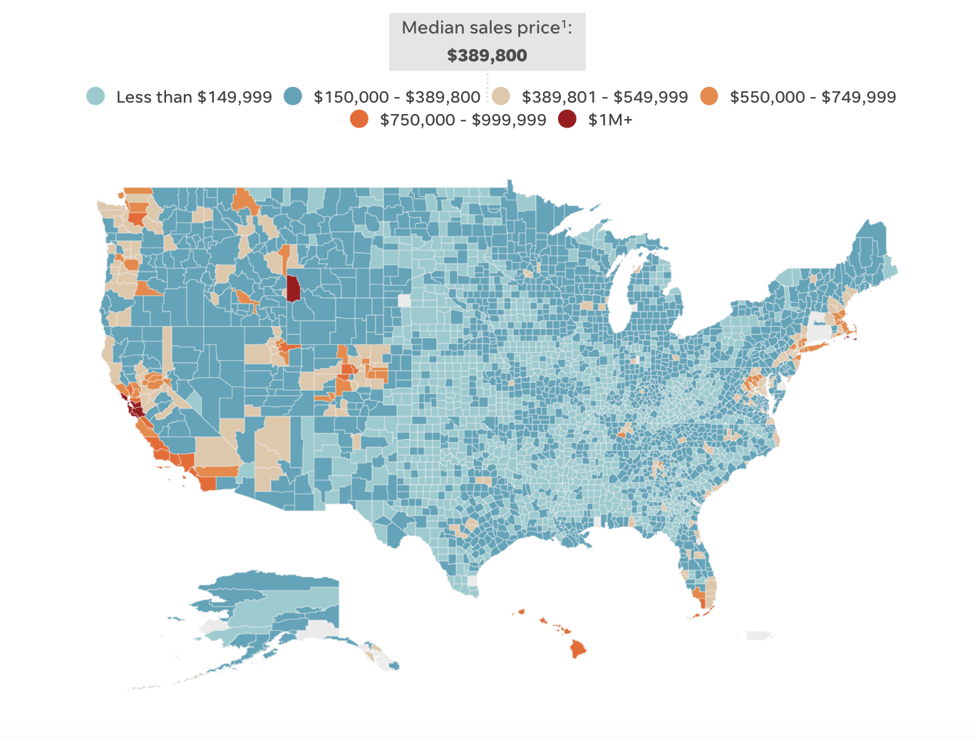
Project Background
How have the effects of a global pandemic impacted the US housing market?
Without any analysis, we first predicted that a rise in COVID cases would lead to a decrease in housing prices
More populated areas are more likely to be affected
California is one of the largest and most populous states, and the most expensive
Median US House Prices by County in 2023
Notes:
Mariam
We first began with our initial guiding question of:
W/o analysis: Rise in covid decrease in housing: we thought this due to the news headlines we were reading when we were at the initial phases of our project and solidifying our research question, as well as general experiences we were hearing about, including more friends and families buying houses during this time
Cali: As many groups have mentioned so far, we used California as the state to explore our question. As you can see from this USA today map, and as many of us have already mentioned, California has a dense population, and then in our research we found that they have a pretty active housing market which isn’t surprising along with a very robust economy.
https://www.usatoday.com/story/money/2024/03/12/most-expensive-housing-markets-in-america/72930811007/
We chose california because of its large population, active housing market, and one of the most economically robust areas of the U.S.

Slide 3


Project Datasets
Zillow Home Value Index Dataset
Zillow has predicted a home value index for every month
Allows us to see direct fluctuations of housing prices per month
Data starts in the 2000s, we focused on the 2020 - onward data
New York Times COVID-19 Dataset
NYT released cumulative counts of COVID cases at the state and county level
Real-time tracking with 1932 counties
Grouped the county data up to the state level for our analysis
Notes:
MARIAM
The Zillow dataset was also pulled from the Federal Reserve - standardized

Slide 4
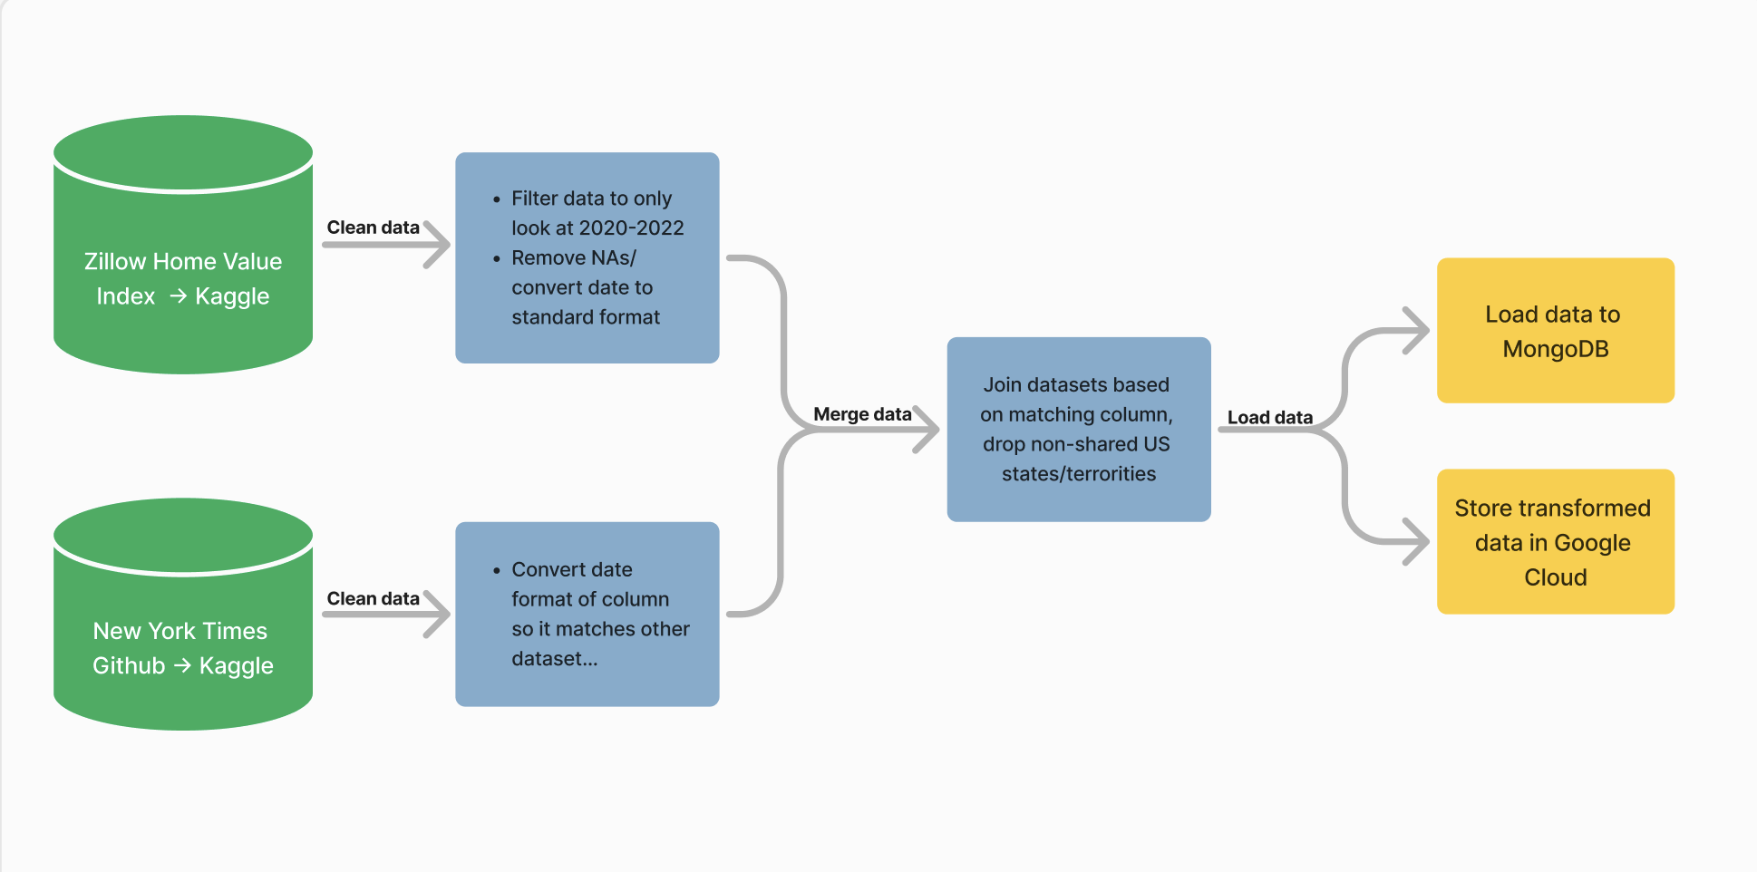
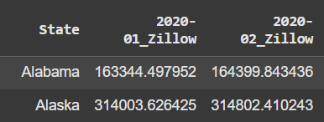
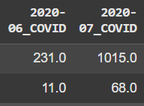
ETL Process
Notes:
EMILY ZHOU
Time 1:30
Let’s walk through our ETL process.
The data is sourced from two locations: Zillow's Home Value Index and a dataset on COVID cases from New York Times, both hosted on Kaggle.
Cleaning
First, we cleaned the data. For Zillow, we filtered the data to include only records from 2020 to 2022 since we wanted to focus on housing prices over the duration of COVID, remove missing values, and standardize date formats.
For the COVID New York Times data, we similarly align the date format to match the Zillow dataset. We made the choice here to focus on just cases, rather than deaths, and also had to handle 110k entries for this specific dataset bc it was a DAILY count from 1/21/2020 to 3/9/2021
One significant challenge was aligning the two datasets to have the same column structure. We had to pivot the dataframes, reset their indices, and add suffixes to the column headers (e.g., _Zillow and _COVID) to differentiate between the two datasets during the merge process, as seen in the bottom right corner. This ensured the columns were consistent and manageable for downstream tasks.
Cleaning
Next, the cleaned datasets are merged based on a common column, which was the state names. During this step, any non-shared U.S. states or territories are excluded, ensuring the datasets align perfectly.
Loading
Once merged, the processed data is prepared for loading. It’s uploaded into a MongoDB database for easy querying and long-term storage which was relatively straightforward as we already have experience with that. Additionally, the transformed data is stored in Google Cloud for scalability and accessibility.
Google cloud was a bit of a hassle to handle, as previous groups mentioned
Doesn’t support direct API key
Had to use service account and download a private key
Had to read a lot of documentation in order to get our google cloud set up but it worked in the end
summ
Our code uses pandas for cleaning and merging, PyMongo to connect to MongoDB, and Google Colab's tools for exporting CSV files. The pipeline ensures the data is clean, consolidated, and stored in multiple formats for various use cases. With this setup, analysis can be performed seamlessly on reliable data.

Slide 5
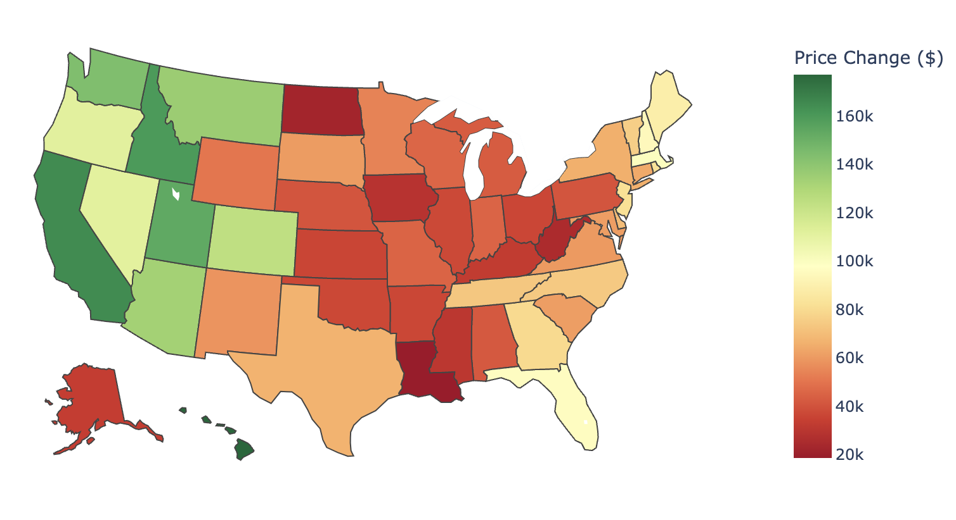
Change in Average Zillow Housing Prices (2020 v. 2022)
NOTABLE STATES
Compared to other states, California and Hawaii had the largest price increase. The west coast as a whole the biggest rise in home value.
Notes:
EMILY SUN
For our analysis, we first wanted to look at how housing prices have changed over the 3 years when COVID affected the US the most.
We used the Python library Plotly to create a chloropleth map, which is a map that basically plots regions against a statistical variable so in this case, we were looking at states vs their housing price change.
When looking at the map, we can see that all housing prices increased but it ranges from 20k to 160k, with California having one of the largest price increases. The west coast in general had the biggest rise in home value, and we attribute that to during COVID, many people wanted their own space and more land, which states like Idaho and Montana can provide. As we mentioned before, California is one of the most populous and economically robust states, so we expected that California would show the most drastic change.

Slide 6
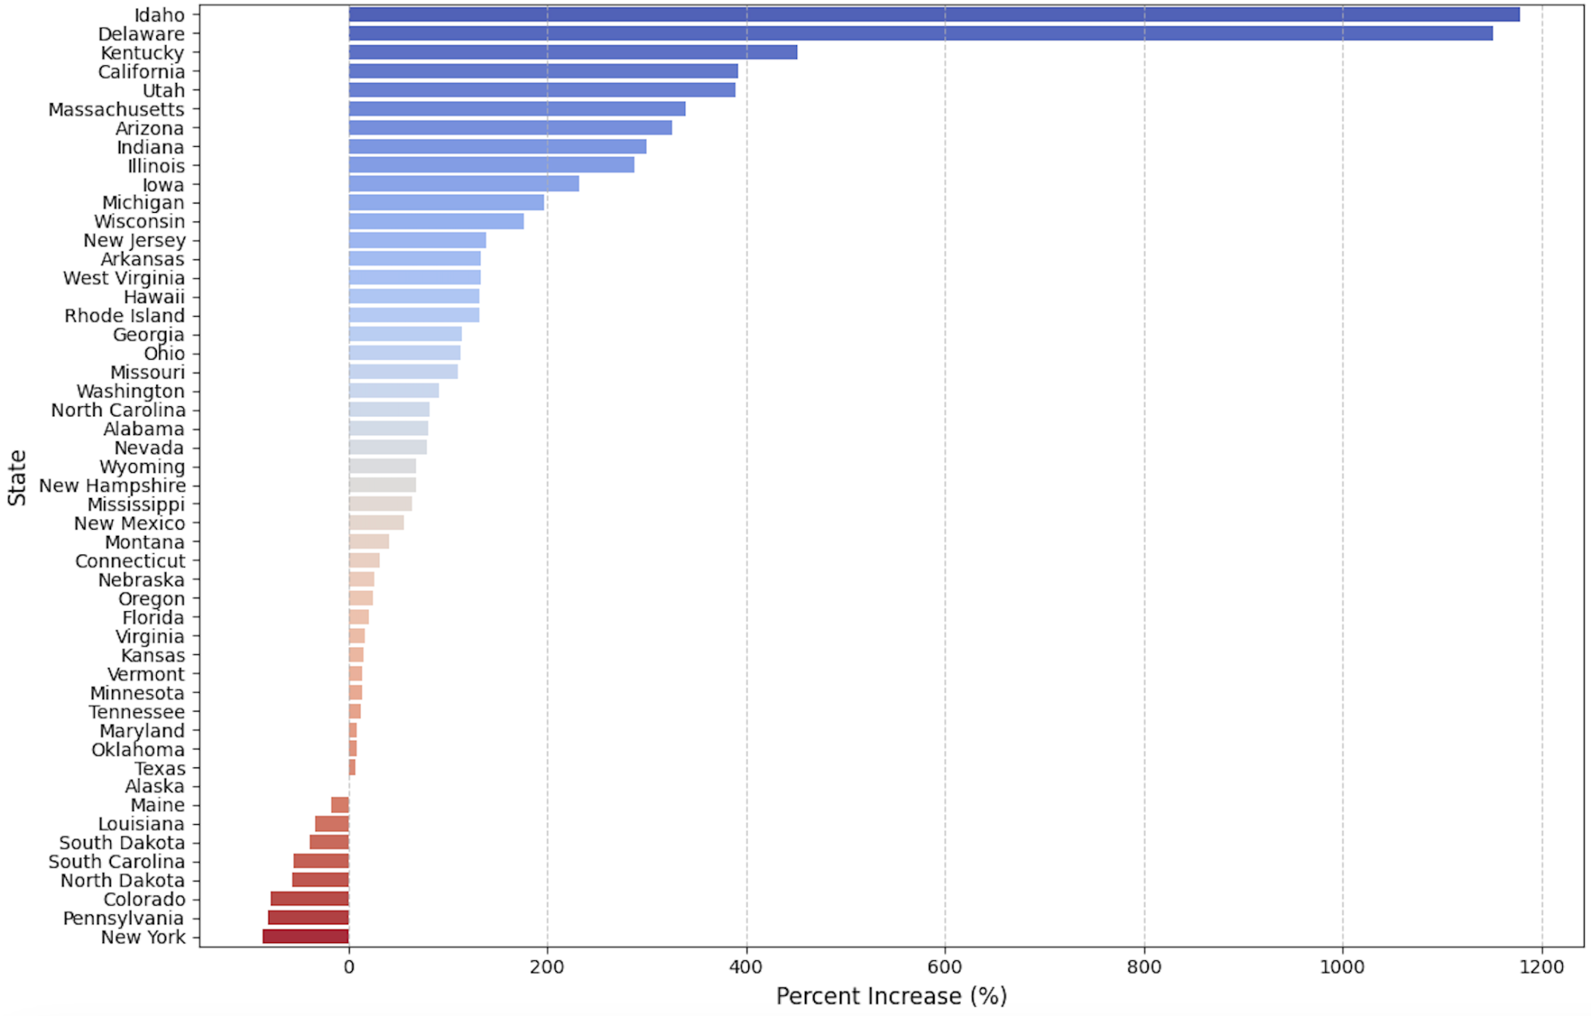
Percent Increase in COVID Cases
NOTABLE STATES
California was among the top 5 states who saw the largest % increase (391.5%) in COVID cases from 2020-2021.
Notes:
EMILY SUN
We also wanted to look at the percent increase in COVID cases, since our initial hypothesis was that an increase in covid cases would lead to a decrease in housing prices.
We used the Python library matplotlib to create a bar chart of all 50 states and their percent change in covid cases from 2020 to 2021. Looking at the bar chart, we had a couple of outlier states in Idaho and Delaware. geographically, those two places are pretty different, we can probably conclude that there’s not a significant relationship between where a state is geographically and the number of covid cases.
Since we were initially focusing on California, we noticed that California was among the top 5 states who saw the largest % increase in COVID cases from 2020-2021. From the previous slide, California had one of the largest increase in home value, so we realized that our initial hypothesis was wrong. One limitation of this is that we only were able to look at the percent change for one year due to the nature of our dataset, but it was interesting to see the trends of certain states.

Slide 7
Project Reflection
01
Importance of data normalization
How the data science/ETL life cycle is iterative
Insights on U.S. response to economic disturbances
Takeaways
02
Data compatibility, unexpected results with datasets
Potential improvements to make
Challenges
03
Limitations
Dataset constraints (e.g. NYT dataset did not have data on COVID cases in 2022)
File format constraints
Our initial prediction was incorrect - housing prices increased as COVID cases rose
This could be due to increased demand driven by low mortgage interest rates and work-from-home policies
04
Conclusion
Notes:
TERESA (takeaways, limitations, conclusion) & EMILY Z (challenges)
Timed: 3 minutes
Merging data:
The way that the data that was formatted was very different between the two of them
Because it was formatted differently, having to condense everything to just months in the columns and then have all the states as the rows, and compiling it into a final dataset: it was a lot of playing around with pandas, the functions were not built to handle something as finicky as what we were trying to do
In the end everything was cleaned up and has the same headers
Takeaways/Limitations/Conclusions:
Takeaways: importance of data normalization (important for our project bc time/place were measured in different ways)
Data science life cycle is an iterative process - continually adjusted our research question and plans to explore the data (iterative process was just a point that was hammered in my data ethics class, but can cut if it sounds odd); DBMS and cloud storage services were new to us, too
Homevalue incr, housing activity incr to stimulate economy; this could be a good starting point for future projects on uncertainty on housing market behavior
Challenges - Emily!
Finding a good dataset
I’ve already worked with REALLY popular housing datasets that were intended for logistic regression and machine learning such as the Ames, Iowa Housing dataset or just the general california housing dataset so we initially considered using those but due to the nature of most of the housing datasets on kaggle being similar to these machine learning datasets, there was too much feature engineering required in order to make two datasets compatible.
Covid datasets were pretty all over the place in what they were tracking, the one we used still wasnt great either since it required a decent bit of logic to extra the monthly cases by state rather than a cumulative monthly
I won’t reiterate too much here about the dataprocessing since i’ve already covered it during our etl process but
Realizing that our two datasets were not necessarily the most compatible was a bit unfortunate but proved a useful opportunity to mess around with
Wish we had some other alternatives to include in our analysis, such as another way to analyze the supply chain during covid that may have affected the habits of home buyers as well as housing prices
Not being terribly sure on how to include this after some deliberation, so we just focused on covid -> housing prices
Limitations:
Missing values for some states in some months, COVID data only available for some years - limited our sample size but also the scope of our research question if we wanted to explore housing pre-pandemic and ”new normal”
Zillow Home Index represents at state level; perhaps future projects could look at housing at the county/neighborhood level to explore the migration trend of urban to suburban housing
Our familiarity with just CSV/JSON file formats
Conclusions
Quickly resummarize analysis findings
Possible explanations: low mortgage interest rates, work from home needs
Because our predictions were wrong this experience showed us the value of using data to inform decisions because they can point out and direct conversations to alternate possibilities like in our case.
Ending words/thank you

Slide 8
Thank you for listening!
Any questions?

